Slide 1

Irish Car Market Analysis
for the years 2019-2024 based on Python
Zixuan(Gia) Gao Date: 29/10/2024

Slide 2

1
Data Preparation
2
Analysis
3
Conclusions
4
Future Work

Slide 3
1
Data Preparation

Slide 4


Data Preparation
Analysis
Conclusions
Future Work
Plotly
5
Interactive Data Visualization
Pandas
Preliminary data analysis
3
4
Pandas
Data Extraction and Preparation
Matplotlib + Seaborn
1
2
Static data visualization
NumPy + Pandas + re
Data processing and cleaning

Slide 5
Data Preparation
Analysis
Conclusions
Future Work
Recheck
04
Fill Category Variables
print(df.dtypes)
df.to_csv("updated_motion_data.csv",
index=False)
df['Model'].where(~df['Model'].str.contains(r'\d{1,2}-[A-Za-z]{3}', na=False), df.groupby(['Make’, 'Bodytype'])['Model'].transform(lambda x: x.mode().iloc[0] if not x.mode().empty else None))
02
03
01
Fill Numerical Variables
Data type conversion
df['Price'].where(~price_condition, df.groupby(['Make', 'Model', 'Fuel', 'Bodytype'])['Price'].transform(lambda x: x[x != -1].mean() if not x.empty else None))
pd.to_datetime()
df[cols_to_str].astype(str)
df[cols_to_numeric].apply(pd.to_numeric, errors='coerce')

Slide 6
2
Analysis

Slide 7
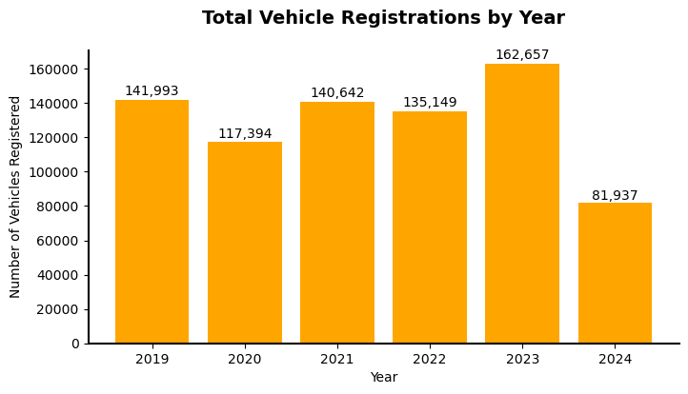
Data Preparation
Analysis
Conclusions
Future Work
Topline Analysis
Market Trend
Buyer Preferences
Reasons For TOYOTA Increase
The data is available up to April 2024.

Slide 8
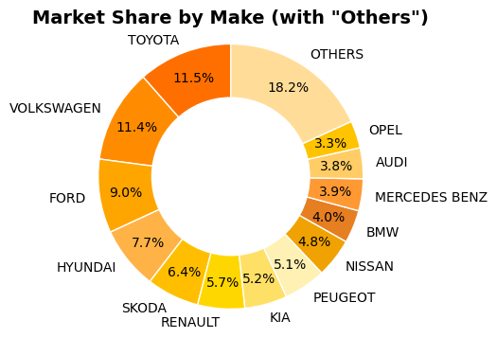
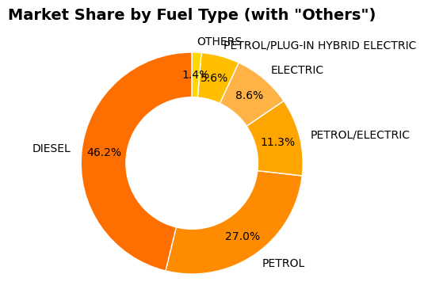
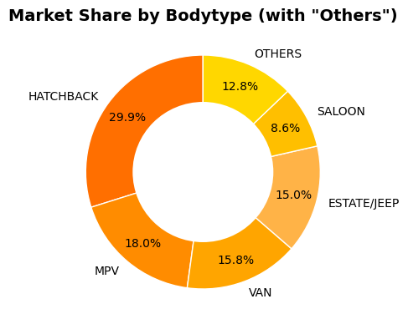
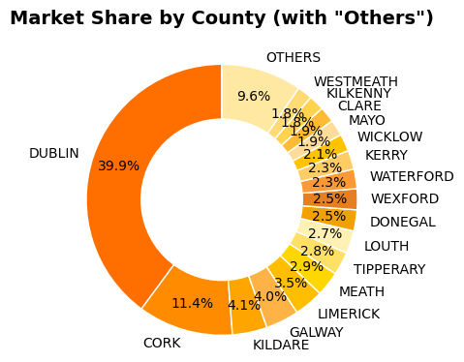
Data Preparation
Analysis
Conclusions
Future Work
Topline Analysis
Market Share
Buyer Preferences
Reasons For TOYOTA Increase

Slide 9
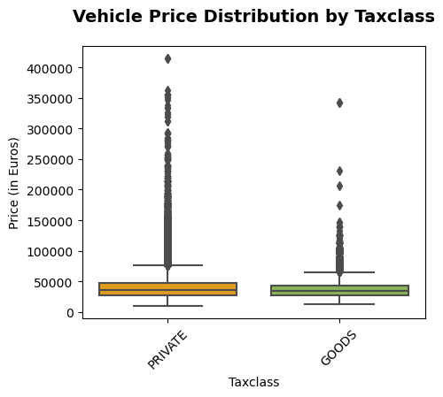
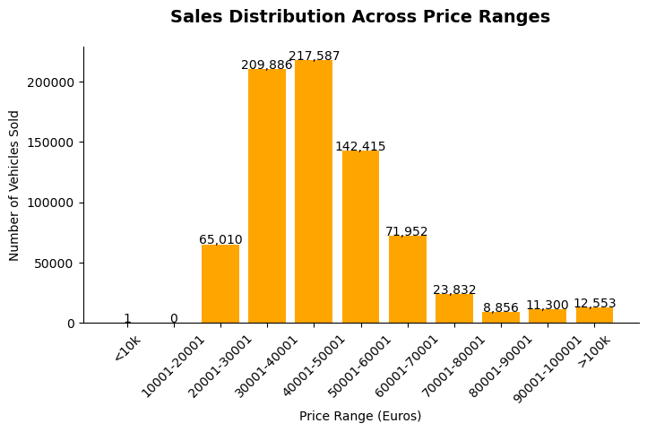
Data Preparation
Analysis
Conclusions
Future Work
Topline Analysis
Pricing Insights
Buyer Preferences
Reasons For TOYOTA Increase

Slide 10
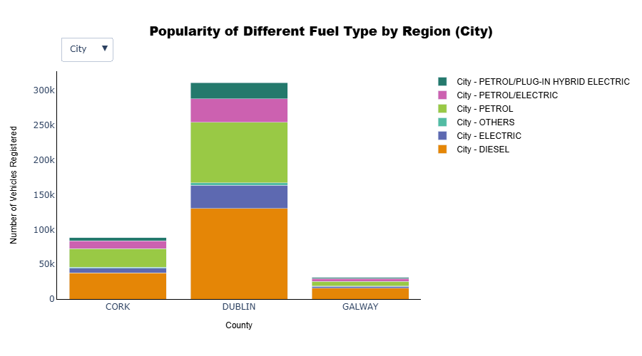
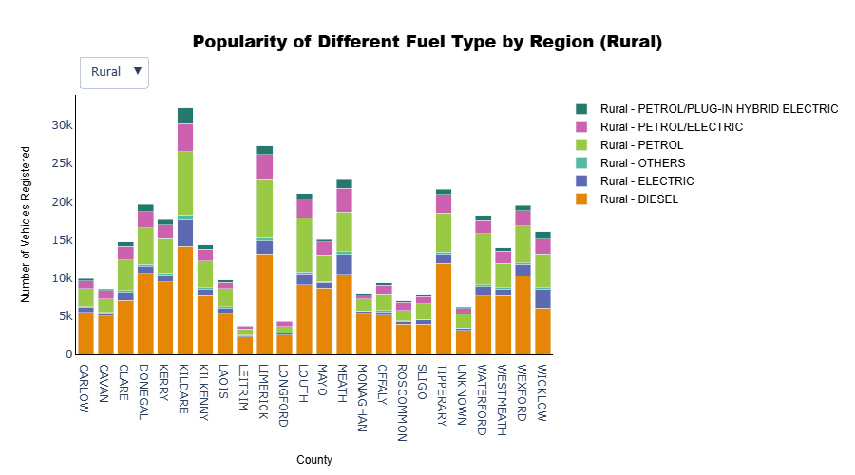
Data Preparation
Analysis
Conclusions
Future Work
Topline Analysis
Geographical Distribution
Buyer Preferences
Reasons For TOYOTA Increase
Link Chart

Slide 11
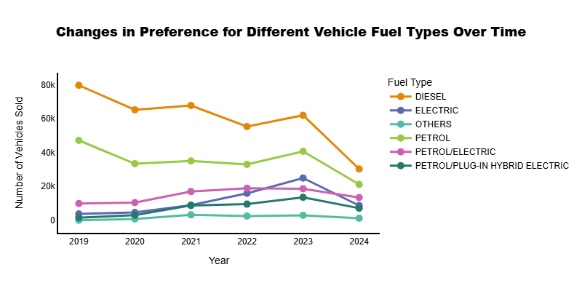
Data Preparation
Analysis
Conclusions
Future Work
Topline Analysis
Adoption of
Eco-Friendly Vehicles
Buyer Preferences
Reasons For TOYOTA Increase
The data is available up to April 2024.
Link Chart

Slide 12
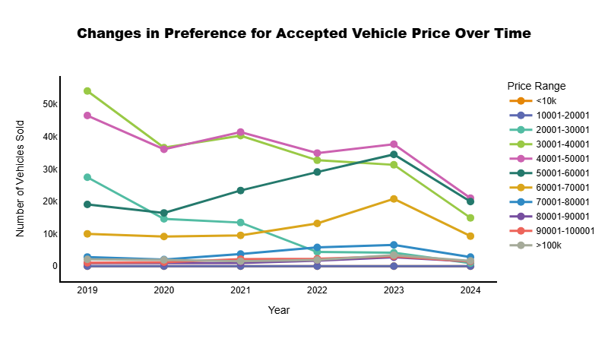
Data Preparation
Analysis
Conclusions
Future Work
Topline Analysis
Preference for
Mid-Range Prices
Buyer Preferences
Reasons For TOYOTA Increase
The data is available up to April 2024.
Link Chart

Slide 13
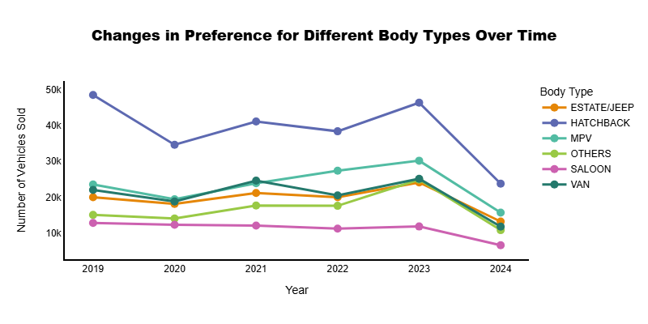
Data Preparation
Analysis
Conclusions
Future Work
Topline Analysis
Diverse
Body Type Choices
Buyer Preferences
Reasons For TOYOTA Increase
The data is available up to April 2024.
Link Chart

Slide 14
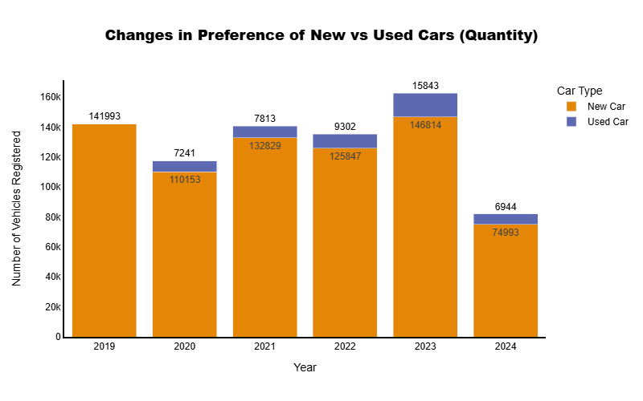
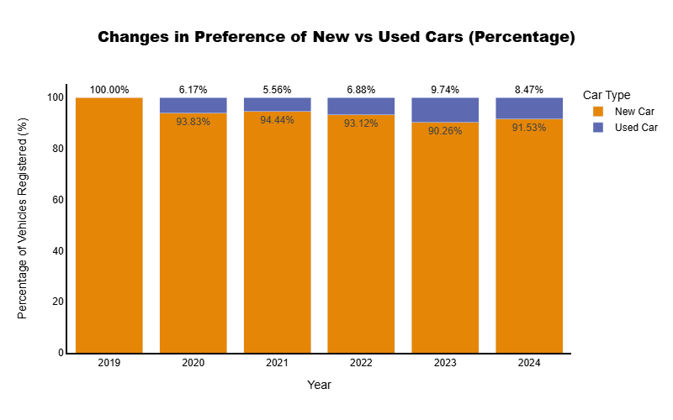
Data Preparation
Analysis
Conclusions
Future Work
Topline Analysis
Economic Influence
on New vs. Used
Buyer Preferences
Link Chart
The data is available up to April 2024.
Reasons For TOYOTA Increase
Link Chart
The data is available up to April 2024.

Slide 15
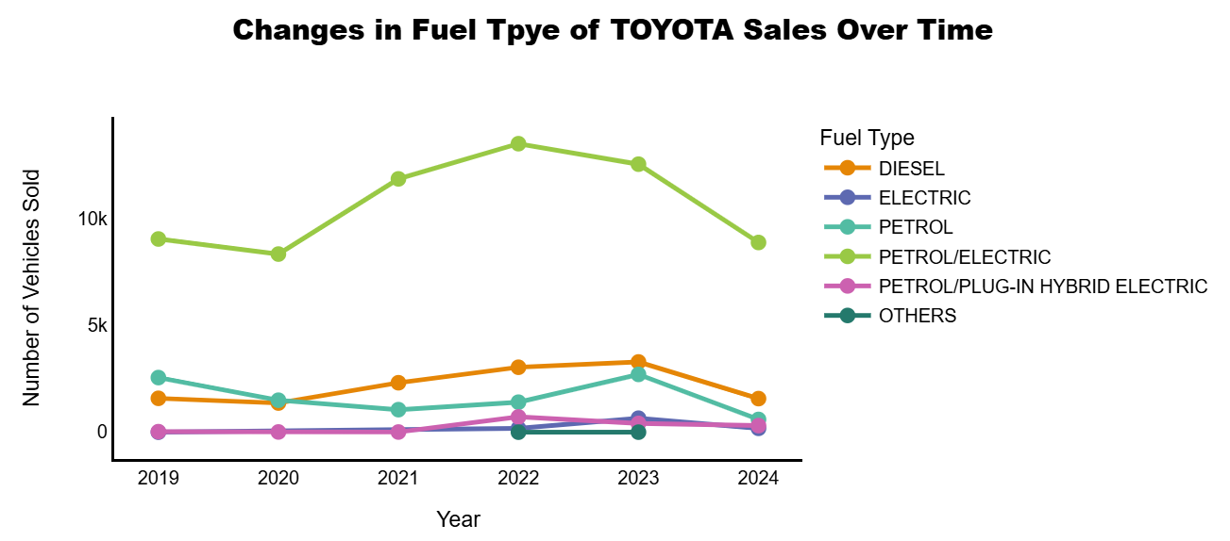
Data Preparation
Analysis
Conclusions
Future Work
Topline Analysis
Fuel Type diversification
Buyer Preferences
Reasons For TOYOTA Increase
The data is available up to April 2024.
Link Chart

Slide 16
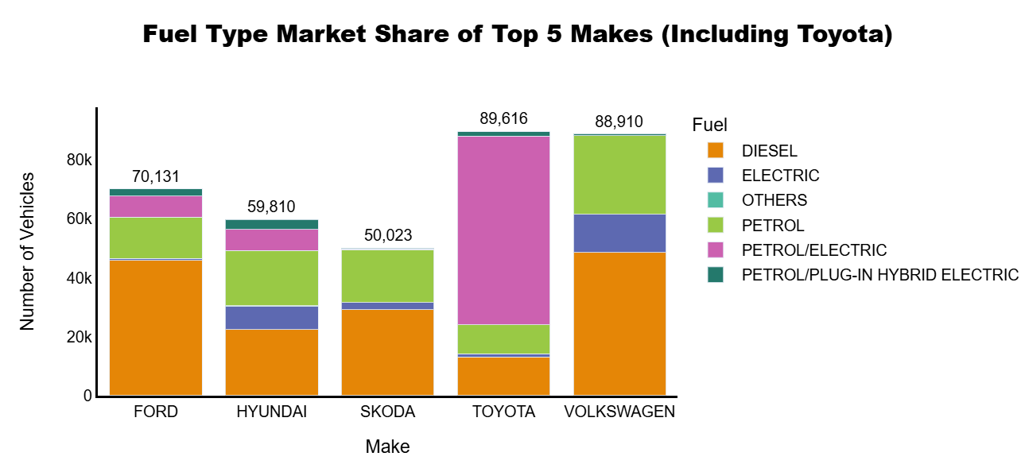
Data Preparation
Analysis
Conclusions
Future Work
Topline Analysis
Competitiveness
in major fuel types
Buyer Preferences
Reasons For TOYOTA Increase
Link Chart

Slide 17
3
Conclusion

Slide 18
Data Preparation
Analysis
Conclusions
Future Work
Topline Analysis
The Irish automotive market shows fluctuations in vehicle registrations across different years, especially influenced by external factors such as the pandemic.
Geographically, Dublin is the primary automotive market, while other regions have relatively dispersed market shares.
The diversity in fuel types and body types reflects the varied demands of consumers.
Buyer Preferences
Market Trends
Geographical Distribution
Fuel & Body Type
Brand Competition
Pricing Insights
Reasons For TOYOTA Increase
Multiple brands with strong market positions, but no single brand is dominating the market.
Mid-range vehicles are the most popular among consumers, indicating a preference for affordable and high-value options in the Irish market.

Slide 19
Data Preparation
Analysis
Conclusions
Future Work
Topline Analysis
Preference for
Mid-Range Prices
Adoption of
Eco-Friendly Vehicles
Buyer Preferences
Reasons For TOYOTA Increase
Economic Influence
on New vs. Used
Diverse
Body Type Choices

Slide 20
Data Preparation
Analysis
Conclusions
Future Work
Topline Analysis
Strong Performance
of Hybrid Models
Government Incentives
Ireland has promoted eco-friendly vehicles through subsidies and tax cuts, reducing the cost of hybrids and electric cars, making Toyota more appealing.
Toyota has a clear advantage in the hybrid vehicle sector, meeting the market's demand for environmentally friendly vehicles.
Buyer Preferences
Diverse Fuel Type Coverage
Emission Taxes
Carbon emission taxes and restrictions on high-emission vehicles have encouraged consumers to opt for low-emission hybrid cars.
Reasons For TOYOTA Increase
Toyota also offers diesel and petrol vehicles, attracting a more diverse group of consumers.

Slide 21
4
Future Work

Slide 22

Data Preparation
Analysis
Conclusions
Future Work
Detailed Analysis of Vehicle Configuration Demand
Use clustering analysis to group similar configuration demands and identify high-demand configuration combinations
Time Series Forecasting
sales trends
Forecast vehicle sales trends for 2024 and the coming years
Seasonality and Cyclical Factors Analysis
Identify changes in car buying preferences across different quarters or months
Market
Segmentation Analysis
Segment the market based on multiple dimensions such as geographical distribution, fuel type, and price range
Policy Impact Assessment
compare the timing of policy implementations with sales data

Slide 23
Thanks!
Q &A
Zixuan(Gia) Gao Date: 29/10/2024

